Slide 1
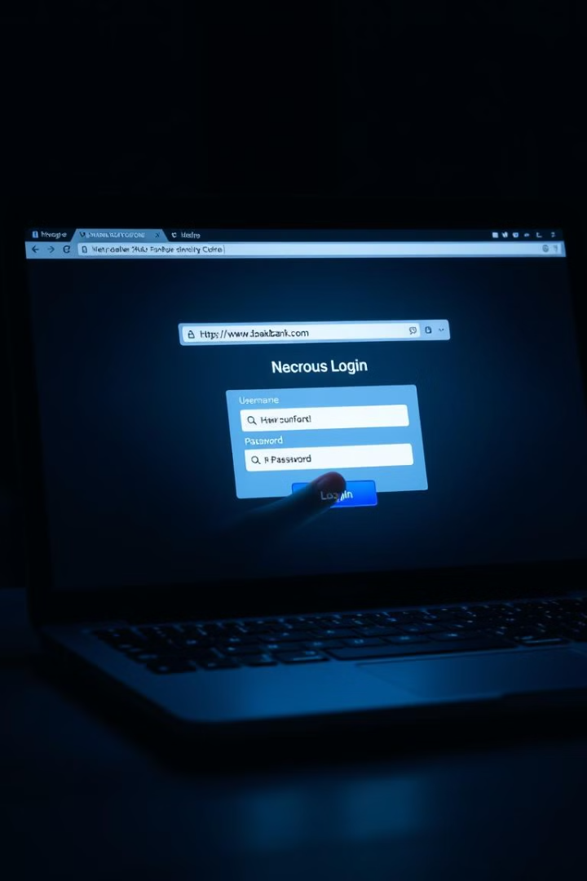
What is Phishing?
Phishing is a type of online scam where attackers try to trick you into giving away personal information, like passwords or credit card numbers. They often do this by pretending to be a trustworthy source, like a bank or a popular website.
For example, you might receive an email that looks like it's from your bank, asking you to click a link and enter your details. If you do, the attackers can steal your information. It’s important to be cautious and verify any requests for personal info before responding!
BY - GOVIND GOPAL KUSHWAH

Slide 2

Common Phishing Attack Examples
1
Email phishing
2
Fake SMS Messages
You get an email that looks like it’s from your bank, asking you to click a link to confirm your account. The link takes you to a fake website.
These messages can tell you that your account has been compromised, or that you need to update your information, and they often include a link to a fake website.
3
Fake Social Media Messages
4
Malware Phishing
These messages might be sent from a fake account that impersonates a friend or colleague, asking you to click on a link or download an attachment.
An email has an attachment that, when opened, installs harmful software on your device.

Slide 3

Identifying Phishing URLs
Look at the URL: Check if the web address starts with "http://" instead of "https://". The "s" means it's more secure.
Check the domain name: Make sure the domain matches the official website. For example, look for "bank.com" instead of "bank-secure.com".
Watch for misspellings: Phishing sites often have typos or extra words. If it looks weird, be cautious.
Shortened links: Be careful with shortened URLs (like bit.ly). Hover over them to see the real link before clicking.
Unusual characters: Look for strange characters or symbols in the URL. They can indicate a fake site.
Generic greetings: Phishing emails may use generic greetings like "Dear customer" instead of your name.
Urgent language: If the URL is from a site asking you to act quickly (like "verify your account"), be suspicious.
Use a link scanner: There are online tools where you can paste a URL to check if it’s safe.

Slide 4

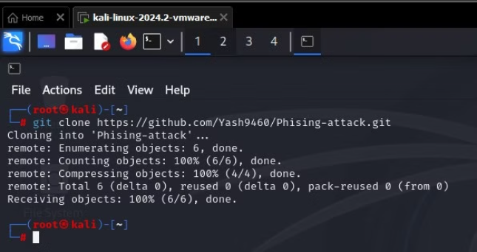
Practical of Phishing Attack
Step 1 - First, we need to install the tool from Github.
2. For installing the tool go to the Github repository of the ZPhisher.
3. Fire up your terminal and write the following commands.
git clone https://github.com/htr-tech/zphisher

Slide 5
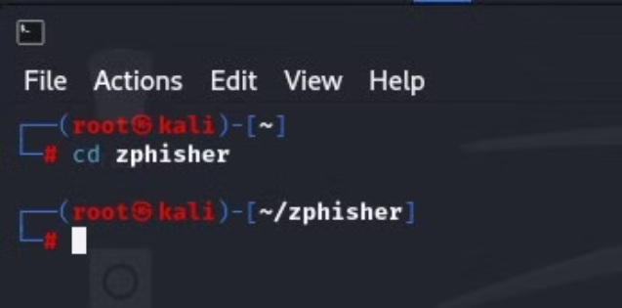
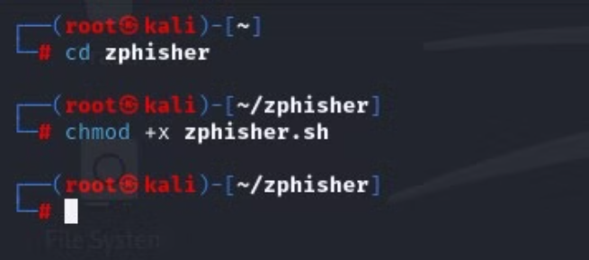
4. Then we need to go inside the zphisher directory using cd command: cd
cd zphisher
Here we need to give executable permission to the bash script by using following command:
chmod +x ​zphisher.sh​

Slide 6
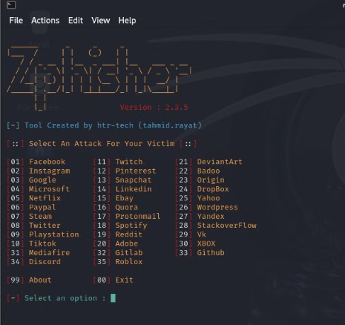
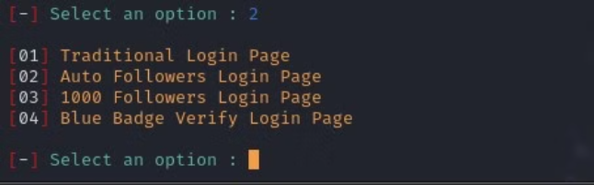
6. Now we are ready to run it. We can run it by using following command:
bash zphisher.sh
7. Here everything is very clear.
For example we choose 02 for Instagram and press enter.

Slide 7
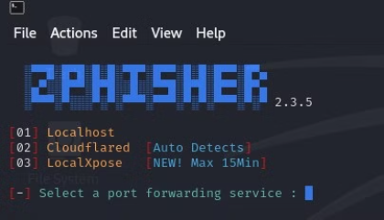
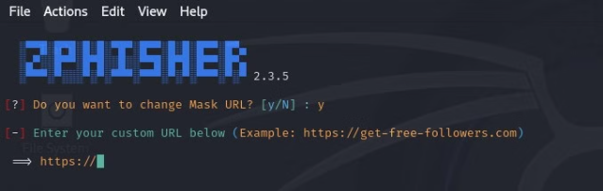
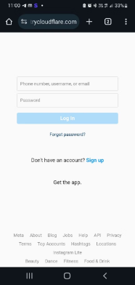
Here we can choose whatever we think easy to trick our victim. For an example we choose 2 for a "Traditional Login Page".
Now if you want to change URL then select Y other then select N and we can seen URL . We will send this URL to the Target.​
As soon as he opens the target link, his Instagram login page will open and as soon as he enters his Id and password,
his information will be displayed on the screen.

Slide 8

Protecting Against Phishing
Check Links: Before clicking on a link, hover over it to see where it goes. If it looks strange, don’t click it.
Verify Emails: Look closely at the sender's email address. If it looks weird or different from what you expect, be cautious.
Use Strong Passwords: Create unique passwords for each of your accounts. Use a mix of letters, numbers, and symbols.
Enable Two-Factor Authentication: This adds an extra step when logging in, making it harder for someone to access your account.
Don’t Share Personal Info: Never give out sensitive information like passwords or credit card numbers over email or text.

Slide 9
THANK YOU

